Slide 1
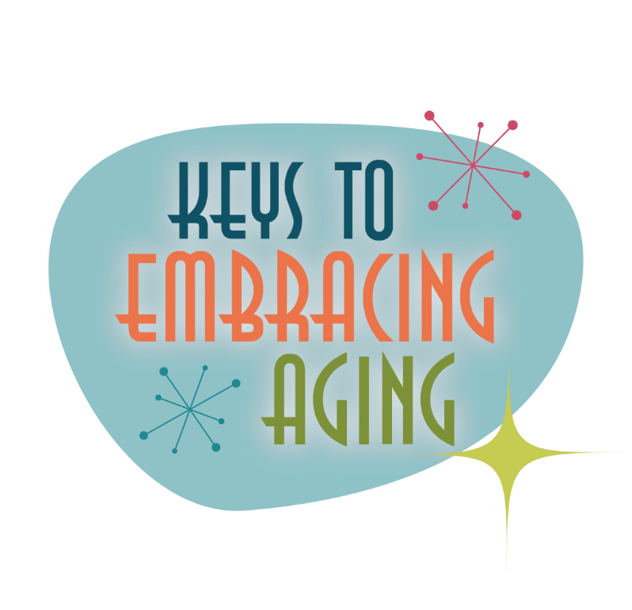
Social Activity

Slide 2
Establishing healthy lifestyle behaviors throughout your life influences optimal aging
Positive Attitude
Eating Smart
Physical Activity
Brain Activity
Social Activity
Tuning Into the Times
Practice Being Safe
Know Your Health Numbers
Stress Management
Financial Affairs
Sleep
Taking Time for You
Notes:
Today we will be concentrating on the power of social activity. But, I wanted to remind you of all of the keys to embracing. Remember—these keys represent lifestyle behaviors. Practiced through the lifespan (although it is never to late to start), these lifestyles contribute to health, well-being, life quality and even longevity.
Attitude is Everything
Eating Healthy
Get Fit
Brain Health
Be Social
Tune-in to the Times
Stay Safe
Know Your Numbers
Manage Your Stress
Financial Affairs
Sleep Tight
Take Time for You
Today we are going to highlight the power of social activity. So, let’s begin by talking about the power of quality versus quantity social interactions.

Slide 3
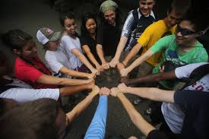
Social Activity
Meaningful social relationships have meaningful results!
Who are your most meaningful relationships with?
Notes:
Today we’re going to be talking about the power of social activity, the importance of relationships with friends and family members, and the value of being connected to others. I want to start today’s lesson by thinking about the first statement – meaningful social relationships have meaningful results. What do you think some of the positive outcomes of having meaningful social relationships are? Now I want you to think about your own life – who are your most meaningful relationships with? Feel free to share with the group if you would like.

Slide 4
Quality vs. Quantity
Meaningful Relationships Require:
Hard work
Dedication
Conscious effort
Communication
Honesty
Respect
Patience
Compromise
Meaningful Relationships Produce:
Joy
Excitement
Support
Love
Empathy
Laughter
Satisfaction
Well-being
Notes:
You might notice that there is often an emphasis on quality over quantity when talking about meaningful social relationships.
QUALITY SOCIAL INTERACTION
Meaningful activity produces the best benefits. The KEY is MEANINGFUL activity/relationships. Think about it this way—You may have 4,000 friends on social media…but how many are you actually connected to? How many actually make you feel good? Needed? How many give you a sense of purpose? This is NOT to say that social media is bad—it’s not—and for some, social media keeps people connected. But again, the key word is MEANINGFUL connections.
Another way to think about meaningful social connections is with the quote: “To the world you may be one person, but to one person you may be the world” (~author unknown).
Quality relationships that develop with close family, friends and significant others help provide ongoing joy, excitement, support, love and purpose. Meaningful relationships require hard work, dedication and a conscious effort. They are often characterized by strong lines of communication, honesty, respect, patience, thoughtfulness, compromise, empathy, laughter and respectful confrontation.
Maintaining a meaningful relationship contributes to the strength of the relationship and plays an important role in the benefits of social activity. While acquaintances and friendships of all kinds are important, meaningful relationships can provide an increased sense of satisfaction and well-being.
It is important for everyone at every age to reflect on the things that matter most and to decide if time and energy are being balanced properly. It is also important to recognize that meaningful social activity will be different for everyone and may change throughout the lifespan. Young children and teenagers, for example, often value time with friends. With age and various life transitions, including various losses, the emphasis may evolve from friends to work to family and back to friends. Especially in later life, relationships and social activities can help you cope with life’s transitions.

Slide 5
Relationships and Health
Meaningful social relationships can lead to improved health, happiness, and well-being!
Notes:
Although meaningful relationships can take work – there are certainly many health-related benefits.
What do you think the positive health benefits of social activity are?
Social activity is good for a person regardless of who you are, how old you are, where you live, or what you do. Being socially engaged with friends, family, and various activities throughout the lifespan has many positive benefits:
Reduced risk of cardiovascular disease
Reduced risk of osteoporosis and rheumatoid arthritis
Reduced risk for some cancers
Reduced risk for Alzheimer’s disease and other dementias
Reduced risk for mental health disorders, such as depression
Better brain vitality
Overall happier and healthier lifestyle
Being socially engaged with friends, family, and various activities throughout the lifespan has many positive benefits:
Improved social skills
Improved academic performance
Positive attitude
Enhanced self-esteem
A sense of connection to peers, groups and the community
Enhanced sense of purpose
Overall happier and healthier lifestyle
What are some risks associated with being socially isolated?
Not being social can lead to depression and social isolation which can negatively affect health and well-being. The risks of social isolation are: loneliness and perhaps depression, and less physical activity.

Slide 6
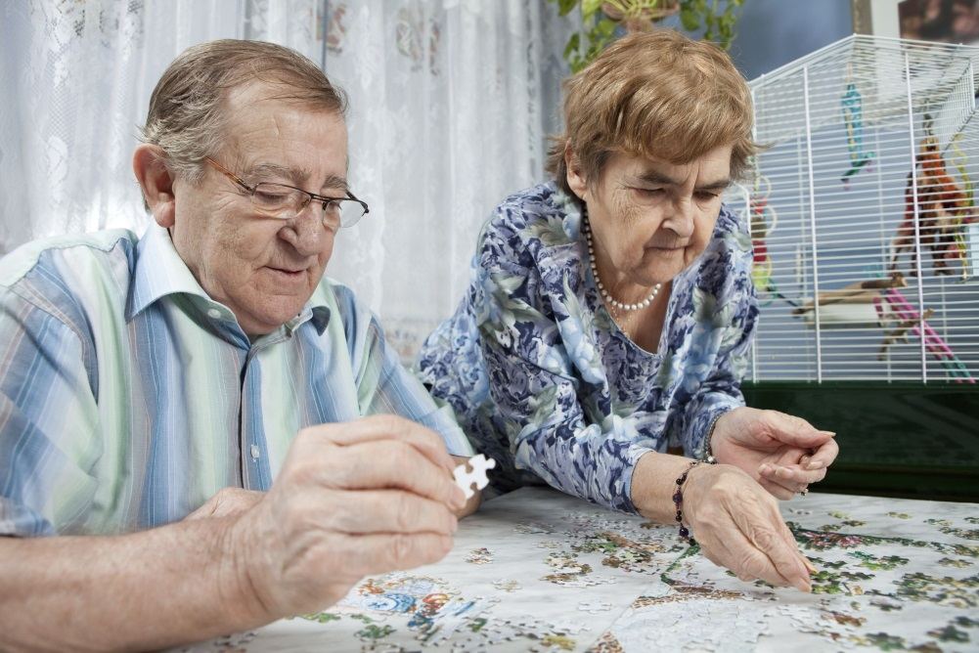
Get Connected
Finding or creating connections with others is the key to social activity.
By engaging with people and participating in activities that you enjoy, social activity can be easy, fun, and fulfilling.
Notes:
GET CONNECTED
Finding or creating connections is a key to social activity.
Social connectedness includes relationships with family, friends, co-workers and other people you interact with as you carry out daily activities, such as your bankers, store clerks and health care providers. These may be people you consistently see or look forward to seeing, people with whom you have something in common or people you trust.
Social connectedness also includes various activities in the community or at home. The types of activities that engage you socially are endless, but it is important to try and seek or create an activity that is meaningful to you.
By engaging with people and participating in activities that you enjoy, social activity can be easy, fun and fulfilling.
Examples of social activities include:
Joining a community center, club or committee
Organizing or attending get-togethers with friends, family or neighbors
Going to a theater, movie, sporting event or festival
Traveling
Eating out
Volunteering
Taking classes
Sign up for a class in your community and try something new like dancing, cooking or yoga. Or volunteer your time at a local shelter or food pantry.
Optional Discussion: Ask participants to brainstorm and share ways that they seek new connections with people.

Slide 7
Be Social
Find a healthy balance between social activity and alone time
Write down your social goals
Create a social activity schedule
Take a class
Volunteer
Participate in a support group
Notes:
THE SOCIAL CHALLENGE (BEING SOCIAL WHEN YOU DON’T WANT TO BE)
It is important to know your personality and social preferences. For some, engaging in social activity is energizing, while others prefer their own inner thoughts and conversations. Some people struggle with social activity because they are depressed. In a case of depression, a person may feel like being alone, but social isolation can actually feed the depression. Even though it can be challenging, the benefits of seeking social activity, including one-on-one interaction with a close friend or even a therapist, are worth the effort and can help ease depressive symptoms. To help keep you connected to the world:
Write down your social goals. Start small and be realistic. Perhaps a goal is to go to the market and say “hi” to the greeter every Saturday or to call a relative or friend once a week.
Create a schedule. You are more likely to participate in things when events are scheduled in advance. Calendars and planning ahead eliminate the ease of saying “no” to a last-minute invitation, force you to create a manageable schedule and take away the anxiety of thinking about what you are going to do.
Take a class. Local community centers, schools/colleges, Cooperative Extension offices, senior centers and public health offices often offer a wide variety of classes on various topics and hobbies.
Volunteer. You may only be one person in the world, but to one person you may mean the world.
Participate in a support group. Support groups introduce you to others who may be facing similar challenges.
While being socially active is critical to health and well-being, everyone has limits on how much time can be spent socially engaged. It is acceptable and healthy to enjoy alone time, as these opportunities help you to reflect on life’s meaning. Engaging in meaningful social activity and establishing healthy lifestyle behaviors throughout your life will influence optimal aging.

Slide 8
“There is no recipe or special formula that spells out meaningful social activity. You have to seek and create opportunities and relationships that are fulfilling and meaningful to you, given your personality and place in the world.”
Notes:
Remember this quote…

Slide 9
Be Social…
THUMBALL!
Notes:
Here is your chance TO BE social today!
Activity: Thumball

Slide 10
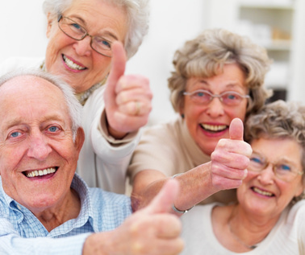
Aging is inevitable…
By embracing a healthy lifestyle throughout your life, you will have a greater ability to engineer a positive approach to the aging process.
Notes:
Aging in an inevitable and unavoidable process. It is a process that brings on many changes as a person progresses from childhood to adulthood. The way in which you take care of yourself through the years both physically and mentally will impact the ways in which you enter your later years. Life does not diminish with aging. In fact, the acceptance of aging can be something that is positive, joyful, and exciting. With aging comes new experiences, knowledge, wisdom and a greater ability to engineer a positive approach to the aging process. I hope today that the Keys to Embracing Aging program highlighted the importance of maintaining social activity throughout your lifespan.

